Slide 1
BUSINESS COMMNUNICATION
PCSE
Sem-1
Notes:
Are your classroom colors different than what you see in this template? That’s OK! Click on Design -> Variants (the down arrow) -> Pick the color scheme that works for you!
Feel free to change any “You will…” and “I will…” statements to ensure they align with your classroom procedures and rules!

Slide 2
COMMUNICATION PROCESS
Elements of the communication process
Channels of communication
Barriers to effective communication
Solutions to barriers to effective communication

Slide 3

COMMUNICATION PROCESS
Elements of the communication process
The communication process consists of a series of steps by which a sender reaches a receiver with a message. It involves six steps:
Develop an Idea : It is an idea or thought which the sender wishes to transmit. This is the key step. Unless there is a worthwhile message to communicate all further steps are rendered useless.
Encode : In this, the idea is encoded with suitable words, charts, or symbols for transmission. At this point, the sender determines the method of transmission.
Transmit : The finally developed message is transmitted by the method chosen. Senders also choose certain channels and communicate with careful timing, but they try to keep their communication channels free of barriers.
Receive : Clear reception of message is a condition precedent to its effective interpretation, storage and use. In an interpersonal mode, it would involve attentive listening too.

Slide 4
COMMUNICATION PROCESS
Elements of the communication process
Decode : Step five is to decode the message so that it can be understood. The sender wants the receiver to understand the message exactly as intended. But, due to different perceptions of two different people, the receiver sometimes does not understand exactly what the sender intends. Hence, the sender must before land assess the abilities of the receiver to make the communication happen.
(6) Feedback : Feedback is the receiver’s response to the sender’s message. Feedback enables the sender to know whether or not his massage has been received and interpreted correctly. The exchange of information through feedback can be very helpful in improving the communication process.

Slide 5

COMMUNICATION PROCESS
II. Barriers to communication
A barrier is any obstacle that prevents us from reaching our goal.
Any hindrance to communication stops the intended meaning of our message from reaching our audience.
Wrong Choice of Medium
Each communication must be transmitted through an appropriate medium. An unsuitable medium is one of the biggest barriers to communication.
So, it is required that medium should be accurate and if wrong or unsuitable medium is selected than it leads to the biggest barrier to communication.

Slide 6

COMMUNICATION PROCESS
2. Physical Barriers
Noise—In factory, oral communication is rendered difficult by the loud noise of machines.
Electronic noise interferes in communication by telephone or loud speaker system.
The word noise is also used to refer to all kind of physical interference like illegible hand writing, bad photo-copies etc.
Time and distance.
— Congestion in telephone and network facilities.
— People working in different shifts.
— Faulty seating arrangement in a hall.
3. Semantic Barriers
• Interpretation of words
A person interprets same word in a different meaning and this will cause barrier between the communications.

Slide 7

COMMUNICATION PROCESS
4. Socio-Psychological Barriers
Attitude and opinions
The information which agrees with opinion and attribute of the individual is favorable for that particular individual.
Emotions
It plays an important role in the act of communication.
If the sender is perplexed, worried, excited, afraid, nervous then he will not be able to organize his message properly.
Closed Mind
A person with a closed mind is very difficult to communicate with. We hold our opinion so rigidly that we just refuse to listen.
Status-consciousness
We are over-conscious of our lower or higher rank and do not express ourselves candidly.

Slide 8
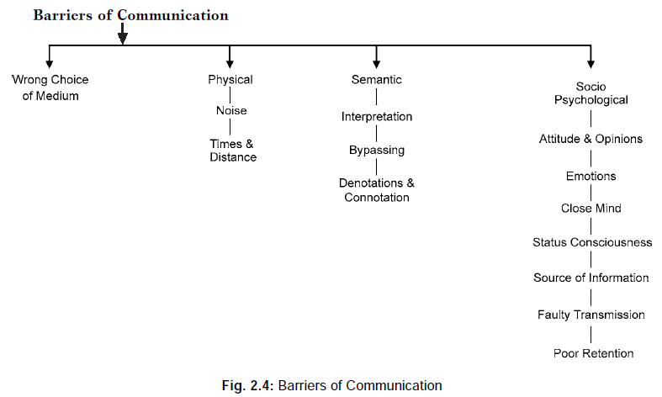
COMMUNICATION PROCESS
The source of information.
We react according to the trust we repose in the source from which the communication originates.
Faulty transmission
Most of part in the message is lost in transmission.
Poor retention
Oral message in particular are lost due to poor human retention ability.

Slide 9
COMMUNICATION PROCESS
5. Cultural Barrier
A Cultural barrier in communication occurs mainly when communication happens between two different cultural backgrounds.
Cultural differences causes behavior and personality differences like body language, thinking, communication, manners, norms, etc. which leads to miscommunication
6. Language Barriers
Language is needed for any kind of communication, even people with speech impairments communicate with sign language and brail.
Communication becomes difficult in situations where people don‘t understand each other‘s language.
7. Gender Barriers
Gender barriers to communication can incite problems at home and in the workplace. Societal stereotypes, assumed gender roles, and interpersonal differences can contribute to a communication gap

Slide 10
COMMUNICATION PROCESS
Women are more likely to talk to other women when a problem or conflict arises. Men are often known for dealing with problems or issues internally
Women focus on feelings, senses and meaning. They rely on their intuition to find answers. Men focus on facts, reason and logic. They find answers by analyzing and figuring things out.
III. Solutions to barriers to effective communication
In order to remove hindrances in the way of communication the following steps are worth consideration:
Clarify Ideas before Communication: The person sending the communication should be very clear in his mind about what he wants to say.
Ensure Proper Feedback: The purpose of feedback is to find out whether the receiver has properly understood the meaning of the information received.

Slide 11

COMMUNICATION PROCESS
Communicate According to the Need of the Receiver: The sender of the communication should prepare the structure of the message not according to his own level or ability but he should keep in mind the level, understanding or the environment of the receiver.
Consult Others before Communication: At the time of planning the communication, suggestions should be invited from all the persons concerned.
Be Aware of Language, Tone and Content of Message: The sender should take care of the fact that the message should be framed in clear and beautiful language. The tone of the message should not injure the feelings of the receiver. As far as possible the contents of the message should be brief and excessive use of technical words should be avoided.
Convey Things of Help and Value to the Listener: The subject matter of the message should be helpful to the receiver. The need and interest of the receiver should specially be kept in mind.

Slide 12

COMMUNICATION PROCESS
Consistency of Message: The information sent to the receiver should not be self- contradictory. It should be in accordance with the objectives, policies, programmers and techniques of the organization. When a new message has to be sent in place of the old one, it should always make a mention of the change otherwise it can create some doubts.
Follow up Communication: In order to make communication effective the management should regularly try to know the weaknesses of the communication system. In this context effort can be made to know whether to lay more stress upon the formal or the informal communication would be appropriate.
Be a Good Listener: It is the essence of communication that both the sender and the receiver should be good listeners. Both should listen to the each other’s point of view with attention, patience and positive attitude. A sender can receive much relevant information by being a good listener.

Slide 13
THANKS FOR YOUR TIME

